Slide 2
Overview
Part 1 - Storage Elements and Analysis
  Introduction to sequential circuits
  Types of sequential circuits
  Storage elements
    Latches
    Flip-flops
  Sequential circuit analysis
    State tables
    State diagrams
    Equivalent states
    Moore and Mealy Models
Part 2 - Sequential Circuit Design
Chapter 5 - Part 1 <number>

Slide 3
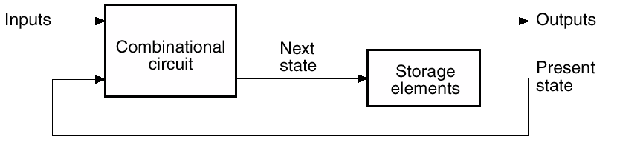
Introduction to Sequential Circuits
A Sequential circuit contains:
  Storage elements: Latches or Flip-Flops
  Combinational Logic:
    Implements a multiple-output switching function
    Inputs are signals from the outside.
    Outputs are signals to the outside.
    Other inputs, State or Present State, are signals from storage elements.
    The remaining outputs, Next State are inputs to storage elements.
Chapter 5 - Part 1 <number>

Slide 4
Introduction to Sequential Circuits
Combinatorial Logic
  Next state function
  Next State = f(Inputs, State)
  Output function (Mealy)
  Outputs = g(Inputs, State)
  Output function (Moore)
  Outputs = h(State)
Output function type depends on specification and affects the design significantly
Chapter 5 - Part 1 <number>

Slide 5
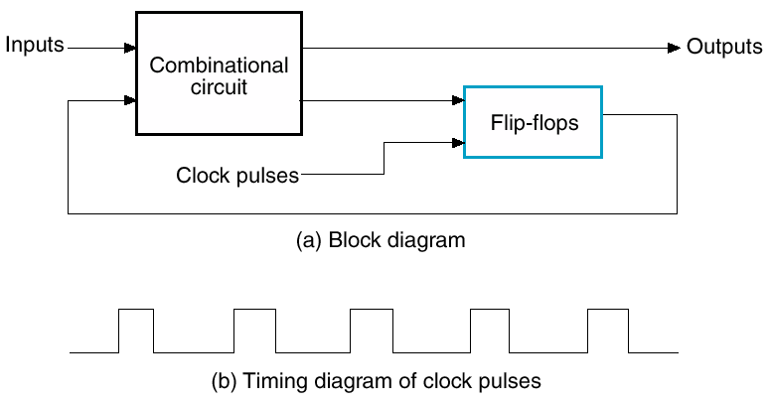
Types of Sequential Circuits
Synchronous
  Storage elements observe inputs and can change state only in relation to a timing signal (clock pulses from a clock)
Asynchronous
  Storage elements can change their state at any instant of time as soon as the input(s) changes.
Chapter 5 - Part 1 <number>

Slide 6
Comparison of Sequential Circuits
Synchronous
  Easier to analyze
  Choose the clock so that changes are only allowed to occur before next clock pulse
Asynchronous
  Potentially faster
  Harder to analyze
Will look mostly at synchronous
Chapter 5 - Part 1 <number>

Slide 7
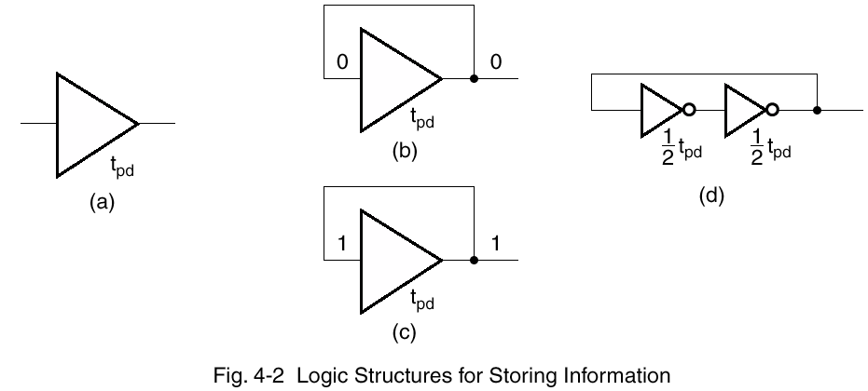
Basic Storage
Apply low or high for longer than t_{pd}
Feedback will hold the value of the input
Stored value can not be changed
Problem ?
Fig. 5-2 Logic Structures for Storing Information
Spring 2008

Slide 8
Basic (NAND) S – R Latch
“Cross-Coupling” two NAND gates gives the S -R Latch:
Which has the time sequence behavior:
S = 0, R = 0 is
forbidden as
input pattern
S (set)
Q
Q
R (reset)
Time
R
S
Q
Q
Comment
1
1
?
?
Stored state unknown
1
0
1
0
“Set” Q to 1
1
1
1
0
Now Q “remembers” 1
0
1
0
1
“Reset” Q to 0
1
1
0
1
Now Q “remembers” 0
0
0
1
1
Both go high
1
1
?
?
Unstable!
Chapter 5 - Part 1 <number>

Slide 9
Basic (NOR) S – R Latch
Cross-coupling two
NOR gates gives the
S – R Latch:
Which has the time sequence behavior:
R (reset)
Q
S (set)
Q
Time
R
S
Q
Q
Comment
0
0
?
?
Stored state unknown
0
1
1
0
“Set” Q to 1
0
0
1
0
Now Q “remembers” 1
1
0
0
1
“Reset” Q to 0
0
0
0
1
Now Q “remembers” 0
1
1
0
0
Both go low
0
0
?
?
Unstable!
Chapter 5 - Part 1 <number>

Slide 10
Clocked S - R Latch
Adding two NAND
gates to the basic
S - R NAND latch
gives the clocked
S – R latch:
Has a time sequence behavior similar to the basic S-R latch except that the S and R inputs are only observed when the line C is high.
C means “control” or “clock”.
As long as C is 0, the output does not change even if S and/ or R change.
S
Q
C
Q
R
Chapter 5 - Part 1 <number>

Slide 11
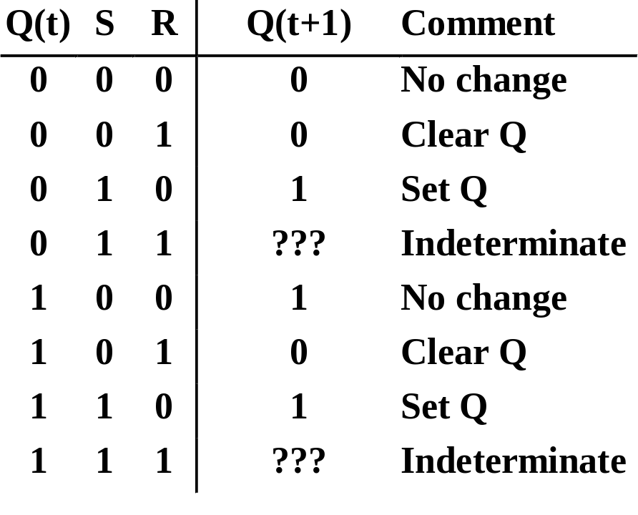
Clocked S - R Latch (continued)
The Clocked S-R Latch can be described by a table:
The table describes
what happens after the
clock [at time (t+1)]
based on:
  current inputs (S,R) and
  current state Q(t).
S
Q
C
Q
R
Chapter 5 - Part 1 <number>

Slide 12

D Latch
Adding an inverter
to the S-R Latch,
gives the D Latch:
Note that there are
no “indeterminate”
states!
D
Q
C
Q
Q
D
Q(t+1)
Comment
0
0
0
No change
D
Q
0
1
1
Set Q
1
0
0
Clear Q
C
Q
1
1
1
No Change
Chapter 5 - Part 1 <number>

Slide 13
Flip-Flops
The latch timing problem
Master-slave flip-flop
Edge-triggered flip-flop
Standard symbols for storage elements
Direct inputs to flip-flops
Chapter 5 - Part 1 <number>

Slide 14
The Latch Timing Problem
The state of the latch is changed only when a clock pulse is available.
As long as this pulse is available, the state of the latch changes based on the latch input.
If the input to the latch changes while the pulse is available this implies a continuous change in the latch state which is used to determine next state and output.
we want the state of the latch to change once per clock pulse.
Chapter 5 - Part 1 <number>

Slide 15
The Latch Timing Problem (continued)
Consider the following circuit:
Suppose that initially Y = 0.
As long as C = 1, the value of Y continues to change!
The changes are based on the delay present on the loop through the connection from Y back to Y.
This behavior is clearly unacceptable.
Desired behavior: Y changes only once per clock pulse
Y
D
Q
Clock
C
Q
Clock
Y
Chapter 5 - Part 1 <number>

Slide 16
The Latch Timing Problem (continued)
The commonly-used solutions replace the clocked D-latch with:
  a master-slave flip-flop
  an edge-triggered flip-flop
Chapter 5 - Part 1 <number>

Slide 17
S-R Master-Slave Flip-Flop
Consists of two clocked
S-R latches in series
with the clock on the
second latch inverted
The input is observed
by the first latch with C = 1
The output is changed by the second latch with C = 0
The path from input to output is broken by the difference in clocking values (C = 1 and C = 0).
The behavior demonstrated by the example with D driven by Y given previously is prevented since the clock must change from 1 to 0 before a change in Y based on D can occur.
S
S
Q
S
Q
Q
C
C
C
R
R
Q
R
Q
Q
Chapter 5 - Part 1 <number>

Slide 18
Flip-Flop Problem
The change in the flip-flop output is delayed by the pulse width which makes the circuit slower or
S and/or R are permitted to change while C = 1
  Suppose Q = 0 and S goes to 1 and then back to 0 with R remaining at 0
    The master latch sets to 1
    A 1 is transferred to the slave
  Suppose Q = 0 and S goes to 1 and back to 0 and R goes to 1 and back to 0
    The master latch sets and then resets
    A 0 is transferred to the slave
  This behavior is called 1s catching
Chapter 5 - Part 1 <number>

Slide 19
Flip-Flop Solution
Use edge-triggering instead of master-slave
An edge-triggered flip-flop ignores the pulse while it is at a constant level and triggers only during a transition of the clock signal
Edge-triggered flip-flops can be built directly at the electronic circuit level, or
A master-slave D flip-flop which also exhibits edge-triggered behavior can be used.
Chapter 5 - Part 1 <number>

Slide 20
Edge-Triggered D Flip-Flop
The edge-triggered
D flip-flop is the
same as the master-
slave D flip-flop
It can be formed by:
  Replacing the first clocked S-R latch with a clocked D latch or
  Adding a D input and inverter to a master-slave S-R flip-flop
The delay of the S-R master-slave flip-flop can be avoided since the 1s-catching behavior is not present with D replacing S and R inputs
The change of the D flip-flop output is associated with the negative edge at the end of the pulse
It is called a negative-edge triggered flip-flop
D
D
Q
S
Q
Q
C
C
C
Q
R
Q
Q
Chapter 5 - Part 1 <number>

Slide 21
Positive-Edge Triggered D Flip-Flop
Formed by
adding inverter
to clock input
Q changes to the value on D applied at the positive clock edge within timing constraints to be specified
Our choice as the standard flip-flop for most sequential circuits
D
D
Q
S
Q
Q
C
C
C
Q
R
Q
Q
Chapter 5 - Part 1 <number>

Slide 22
Standard Symbols for Storage Elements
Master-Slave:
Postponed output
indicators
Edge-Triggered:
Dynamic
indicator
S
S
D
D
R
R
C
C
SR
SR
D with 1 Control
D with 0 Control
(a) Latches
S
S
D
D
C
C
R
R
C
C
Triggered SR
Triggered SR
Triggered D
Triggered D
(b) Master-Slave Flip-Flops
D
D
C
C
Triggered D
Triggered D
(c) Edge-Triggered Flip-Flops
Chapter 5 - Part 1 <number>

Slide 23
Direct Inputs
At power up or at reset, all or part
of a sequential circuit usually is
initialized to a known state before
it begins operation
This initialization is often done
outside of the clocked behavior
of the circuit, i.e., asynchronously.
Direct R and/or S inputs that control the state of the latches within the flip-flops are used for this initialization.
For the example flip-flop shown
  0 applied to R resets the flip-flop to the 0 state
  0 applied to S sets the flip-flop to the 1 state
S
D
Q
C
Q
R
Chapter 5 - Part 1 <number>

Slide 24
Sequential Circuit Analysis
General Model
  Current State
  at time (t) is stored in an array of
  flip-flops.
  Next State at time (t+1) is a Boolean function of State and Inputs.
  Outputs at time (t) are a Boolean function of State (t) and (sometimes) Inputs (t).
Inputs
Outputs
Combina-tional
Logic
Storage Elements
Next
State
State
CLK
Chapter 5 - Part 1 <number>

Slide 25
Example 1 (from Fig. 5-15)
Input: x(t)
Output: y(t)
State: (A(t), B(t))
What is the Output Function?
What is the Next State Function?
x
D
Q
A
C
Q
A
D
Q
B
CP
C
Q
y
Chapter 5 - Part 1 <number>

Slide 26
Example 1 (from Fig. 5-15) (continued)
Boolean equations for the functions:
  A(t+1) = A(t)x(t) + B(t)x(t)
  B(t+1) = A(t)x(t)
  y(t) = x(t)(B(t) + A(t))
x
Q
A
D
C
Q
A’
Next State
D
Q
B
CP
C
Q'
y
Output
Chapter 5 - Part 1 <number>

Slide 27
State Table Characteristics
State table – a multiple variable table with the following four sections:
  Present State – the values of the state variables for each allowed state.
  Input – the input combinations allowed.
  Next-state – the value of the state at time (t+1) based on the present state and the input.
  Output – the value of the output as a function of the present state and (sometimes) the input.
From the viewpoint of a truth table:
  the inputs are Input, Present State
  and the outputs are Output, Next State
Chapter 5 - Part 1 <number>

Slide 28
Example 1: State Table (from Fig. 5-15)
The state table can be filled in using the next state and output equations:
A(t+1) = A(t)x(t) + B(t)x(t)
B(t+1) =‾A (t)x(t)
y(t) =‾x (t)(B(t) + A(t))
Present State
Input
Next State
Output
A(t) B(t)
x(t)
A(t+1) B(t+1)
y(t)
0 0
0
0 0
0
0 0
1
0 1
0
0 1
0
0 0
1
0 1
1
1 1
0
1 0
0
0 0
1
1 0
1
1 0
0
1 1
0
0 0
1
1
1
1
1 0
0
Chapter 5 - Part 1 <number>

Slide 29
Example 1: Alternate State Table
2-dimensional table that matches well to a K-map. Present state rows and input columns in Gray code order.
  A(t+1) = A(t)x(t) + B(t)x(t)
  B(t+1) =‾A (t)x(t)
  y(t) =‾x (t)(B(t) + A(t))
Present
Next State
Output
State
x(t)=0 x(t)=1
x(t)=0 x(t)=1
A(t) B(t)
A(t+1)B(t+1) A(t+1)B(t+1)
y(t) y(t)
0 0
0 0 0 1
0 0
0 1
0 0 1 1
1 0
1 0
0 0
1 0
1 0
1 1
0 0 1 0
1 0
Chapter 5 - Part 1 <number>

Slide 30
State Diagrams
The sequential circuit function can be represented in graphical form as a state diagram with the following components:
  A circle with the state name in it for each state
  A directed arc from the Present State to the Next State for each state transition
  A label on each directed arc with the Input values which causes the state transition, and
  A label:
    On each circle with the output value produced, or
    On each directed arc with the output value produced.
Chapter 5 - Part 1 <number>

Slide 31
State Diagrams
Label form:
  On circle with output included:
    state/output
    Moore type output depends only on state
  On directed arc with the output included:
    input/output
    Mealy type output depends on state and input
Chapter 5 - Part 1 <number>

Slide 32
Example 1: State Diagram
x=0/y=0
x=0/y=1
Which type?
Diagram gets
confusing for
large circuits
For small circuits,
usually easier to
understand than
the state table
x=1/y=0
A B
0 0
x=0/y=1
1 0
x=1/y=0
x=1/y=0
x=0/y=1
0 1
1 1
x=1/y=0
Chapter 5 - Part 1 <number>
Notes:
Type: Mealy

Slide 33
Equivalent State Definitions
Two states are equivalent if their response for each possible input sequence is an identical output sequence.
Alternatively, two states are equivalent if their outputs produced for each input symbol is identical and their next states for each input symbol are the same or equivalent.
Chapter 5 - Part 1 <number>

Slide 34
Equivalent State Example
0
Text Figure 5-17(a):
For states S3 and S2,
  the output for input
  0 is 1 and input 1 is 0,
  and
  the next state for input
  0 is S0 and for input
  1 is S2.
  By the alternative definition, states S3 and S2 are equivalent.
1
S0/0
S1
0/1
0/1
0/1
1/0
1/0
S2
S3
1/0
Chapter 5 - Part 1 <number>

Slide 35
Equivalent State Example
0/0
1/0
Replacing S3 and S2
by a single state gives
state diagram:
Examining the new diagram,
states S1 and S2 are equivalent since
  their outputs for input
  0 is 1 and input 1 is 0,
  and
  their next state for input
  0 is S0 and for input
  1 is S2,
Replacing S1 and S2 by a
single state gives state
diagram:
S0
S1
0/1
0/1
1/0
S2
1/0
0/0
1/0
S0
S1
0/1
1/0
Chapter 5 - Part 1 <number>

Slide 36
Moore and Mealy Models
Sequential Circuits or Sequential Machines are also called Finite State Machines (FSMs). Two formal models exist:
Moore Model
  Named after E.F. Moore
  Outputs are a function ONLY of states
  Usually specified on the states.
Mealy Model
  Named after G. Mealy
  Outputs are a function of inputs AND states
  Usually specified on the state transition arcs.
Chapter 5 - Part 1 <number>

Slide 37
Moore and Mealy Example Diagrams
Mealy Model State Diagram
maps inputs and state to outputs
Moore Model State Diagram maps states to outputs
x=1/y=0
x=0/y=0
0
1
x=0/y=0
x=1/y=1
x=0
0/0
x=0
x=1
x=1
x=0
1/0
2/1
x=1
Chapter 5 - Part 1 <number>

Slide 38
Moore and Mealy Example Tables
Moore Model state table maps state to outputs
Mealy Model state table maps inputs and state to outputs
Present
Next State
Output
State
x=0 x=1
0
0 1
0
1
0 2
0
2
0 2
1
Present
Next State
Output
State
x=0 x=1
x=0 x=1
0
0 1
0 0
1
0 1
0 1
Chapter 5 - Part 1 <number>

Slide 39
Mixed Moore and Mealy Outputs
In real designs, some outputs may be Moore type and other outputs may be Mealy type.
Example: Figure 5-17(a) can be modified to illustrate this
  State 00: Moore
  States 01, 10,
  and 11: Mealy
Simplifies output
specification
0
1
00/0
01
0/1
0/1
0/1
1/0
1/0
10
11
1/0
Chapter 5 - Part 1 <number>

Slide 40
Example 2: Sequential Circuit Analysis
A
Logic Diagram:
D
Q
Z
C
R
Q
B
D
Q
C
R
Q
C
D
Q
Clock
C
R
Q
Reset
Chapter 5 - Part 1 <number>

Slide 41
Example 2: Flip-Flop Input Equations
Variables
  Inputs: None
  Outputs: Z
  State Variables: A, B, C
Initialization: Reset to (0,0,0)
Equations
  A(t+1) = Z =
  B(t+1) =
  C(t+1) =
Chapter 5 - Part 1 <number>
Notes:
A(t+1) = BC
B(t+1) = B’C + BC’
C(t+1) = A’C’
Z = A

Slide 42
Example 2: State Table
X’ = X(t+1)
A B C | A’B’C’ | Z
0 0 0
0 0 1
0 1 0
0 1 1
1 0 0
1 0 1
1 1 0
1 1 1
Chapter 5 - Part 1 <number>
Notes:
A’B’C’: 0 0 1, 0 1 0, 0 1 1, 1 0 0, 0 0 0, 0 1 0, 0 1 0, 1 0 0
Z: 0 0 0 0 1 1 1 1

Slide 43
Example 2: State Diagram
Which states are used?
What is the function of
the circuit?
ABC
Reset
000
111
100
001
011
010
101
110
Chapter 5 - Part 1 <number>
Notes:
Only states reachable from the reset state 000 are used: 000, 001, 010, 011, and 100.
The circuit produces a 1 on Z after four clock periods and every five clock periods thereafter:
000 -> 001 -> 010 -> 011 -> 100 -> 000 -> 001 -> 010 -> 011 -> 100 …
1 1

